Slide 1
Marketing and HR Database in Hospitality Industry
Instructor: Xiaodi Zhu
Date:Dec 5, 2017
Team Member:
Hao Ding
Min Huang
Ni Man
Biyan Xie

Slide 2
Content
Introduction
Database design
Data Collection
Questions & Queries
Implications & Conclusion

Slide 3
Introduction
Trend of Hospitality Industry in 2017
Economic fundamentals makes travel companies → remain optimistic；
Personalized experience；
Spend more time reviewing the services；
Email marketing campaigns.

Slide 4
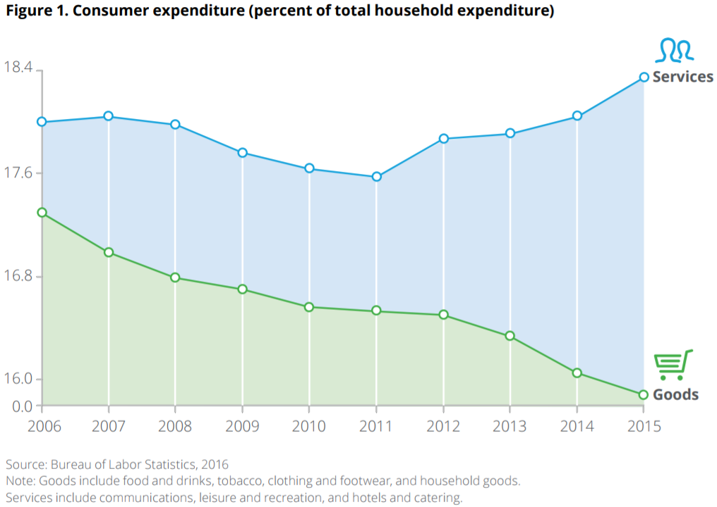
Introduction
Global business travel spending in 2015:
$1.2 trillion
5% up from 2014

Slide 5
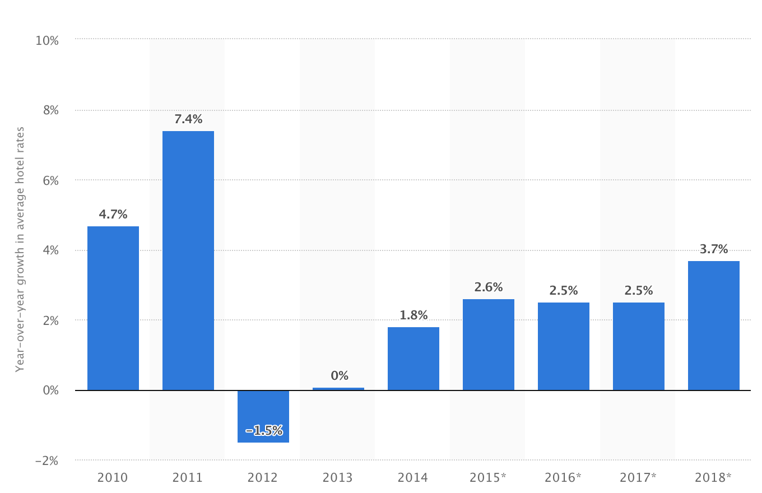
Introduction
Annual Growth in Average Global Hotel Rates from 2010 to 2018
Slow but positive growth in hospitality industry
3.7% in 2018

Slide 6
Objective
Data
Strategy
Fortune
Inspect employees’ performance and improve management efficiency
Generate business strategies through clients’ behaviors

Slide 7
II. Database Design
Department
Client
Employee
Order
Failure Recovery
Promotion
Service & Product

Slide 8
III. Data Collection
Data in October, 2017
Private information is randomly generated
Organization structure is referred to real structure in hospitality industry

Slide 9
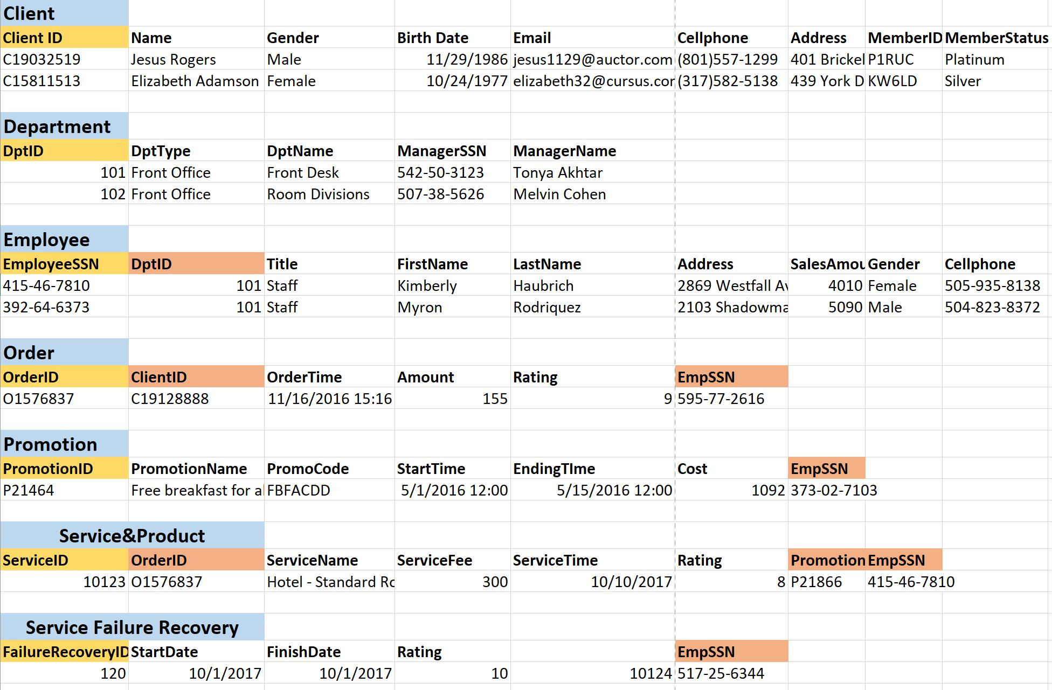
III. Data Collection
Tables
Primary Key
Foreign Key

Slide 10
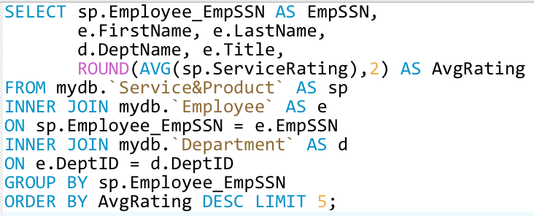
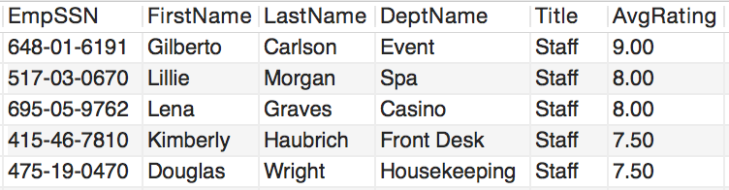
IV.1 Questions & Queries - Best Staff 1
Who are the top five employees receiving highest average service rating?

Slide 11
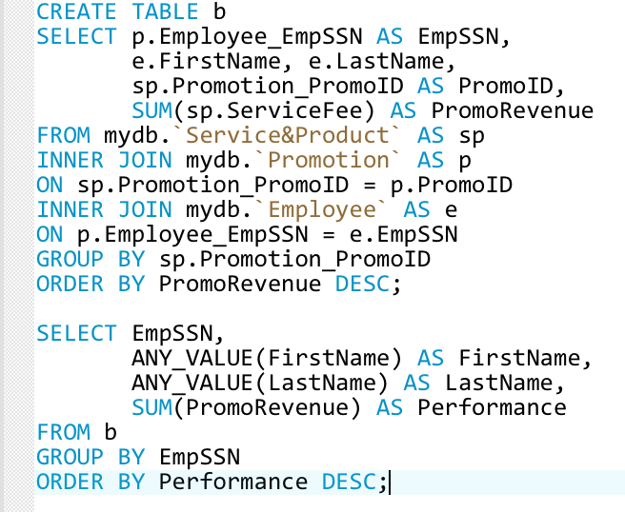
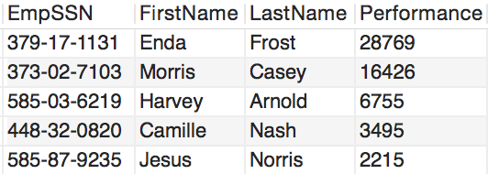
IV.1 Questions & Queries - Best Staff 2
Who are the employees with best performance in Marketing Department?

Slide 12
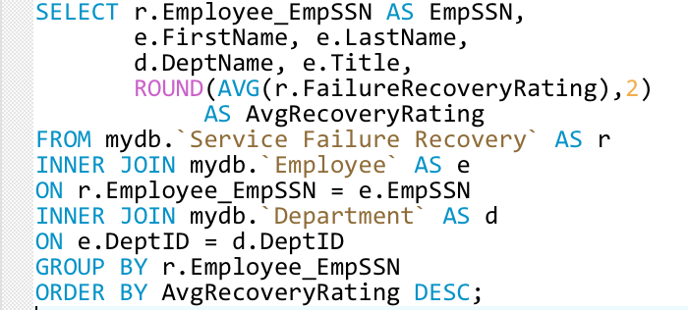
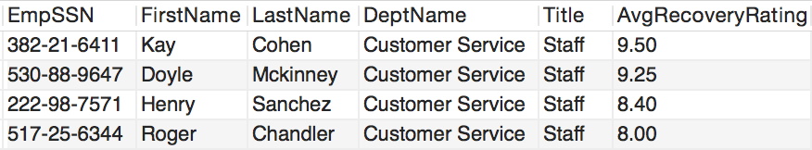
IV.1 Questions & Queries - Best Staff 3
Who are the employees having highest average service recovery rating?

Slide 13
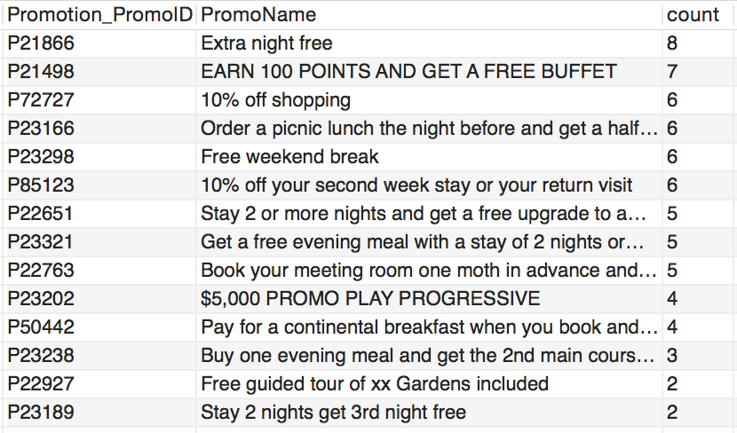
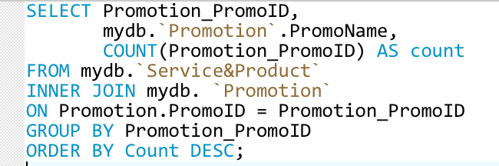
IV.2 Questions & Queries - Promotion 1
What’s the promotion which was used most frequently?

Slide 14
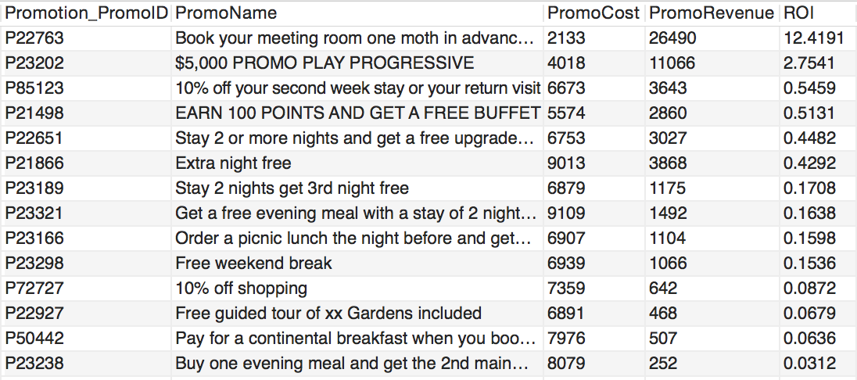
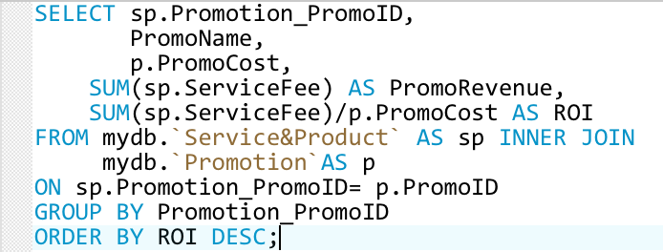
IV.2 Questions & Queries - Promotion 2
What’s the promotion with best ROI (Revenue on Investment)?

Slide 15
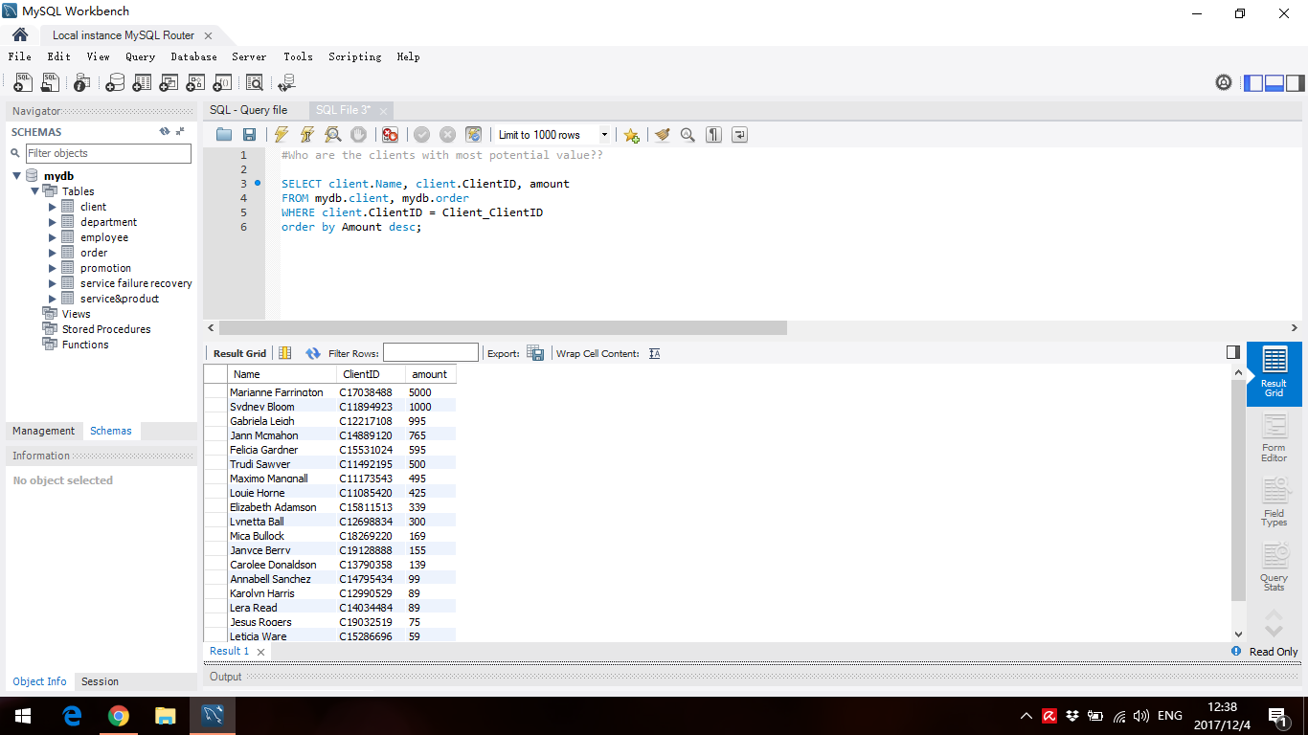
IV.2 Questions & Queries - Promotion 3
Who are the clients with more potential value?

Slide 16
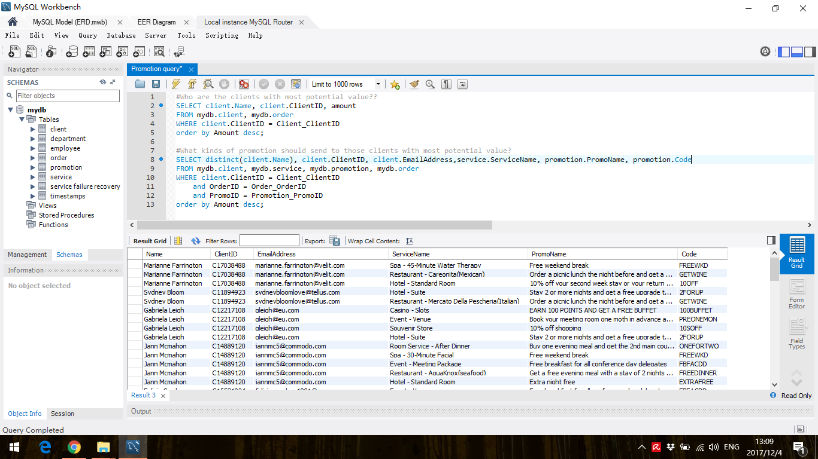
IV.2 Questions & Queries - Promotion 4
What are the promotion codes should be sent to those clients?

Slide 17

V. Implications & Conclusion
Clients:
Hotel
Retail
Main problem & solution:
Best staff
Promotion strategy
Real world Impact:
Marketing
Human Resource

Slide 18
Questions?

